Slide 1

Arrays(1D and 2D)

Slide 2

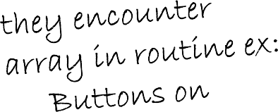



Introduction
Arrays
Collection of related data items of same data type.
Static entity – i.e. they remain the same size throughout program execution

Slide 3

Arrays
Array
– Group of consecutive memory locations
– Same name and data type
To refer to an element, specify:
– Array name
– Position number in square brackets([])
Format:
arrayname[position_number]
First element is always at position 0
Eg. n element array named c:
c[0], c[1]...c[n – 1]
c[0]
-45
6
0
72
3
-89
0
62
-3
1
6453
78
c[1]
c[2]
c[3]
c[4]
c[5]
c[6]
c[7]
c[8]
c[9]
c[10]
c[11]
Position number of the element within array c
@LPU CSE202 C++ Programming

Slide 4
Arrays
An array is an ordered list of values
The entire array Each value has a numeric index
has a single name
c[0] c[1] c[2] c[3] c[4] c[5] c[6] c[7] c[8]
c[9]
79 | 87 | 94 | 82 | 67 | 98 | 87 | 81 | 74 | 91
c
An array of size N is indexed from zero to N-1
This array holds 10 values that are indexed from 0 to 9

Slide 5
Arrays
Array elements are like normal variables
c[0] = 3;/*stores 3 to c[0] element*/
The position number inside square brackets is called
subscript/index.
Subscript must be integer or an integer expression
c[5 - 2] = 7; (i.e. c[3] = 7)

Slide 6
Defining Arrays
When defining arrays, specify:
Name
Data Type of array
Number of elements
datatype arrayName[numberOfElements];
Examples:
int students[10]; float myArray[3284];
Defining multiple arrays of same data type
Format is similar to regular variables
Example:
int b[100], x[27];

Slide 7
Initializing Arrays
Initializers
int n[5] = { 1, 2, 3,4,5};
If not enough initializers given, then rightmost elements become 0
– int n[5] = { 0 }; //initialize all elements to 0
If size is omitted, initializers determine it
int n[] = { 1, 2, 3, 4, 5 };
5 initializers, therefore 5 element array.

Slide 8
Initializing Arrays
Array is same as the variable can prompt for value from the user at run time.
Array is a group of elements so we use for loop to get the values of every element instead of getting single value at a time.
Example: int array[5]; // array of size 5
for(int i=0;i<5;i++)
{// loop begins from 0 to 4
cin>>array[i];
}

Slide 9
Program of Initializing an array to 0
#include <iostream>
using namespace std;
int main()
{
int a[10];
for(int i=0;i<9;i++)
{
a[i]=0;
}
cout<<"Elements of the array are"<<endl;
for(int i=0;i<9;i++)
{
cout<<i<<"\t"<<a[i];
cout<<endl;
}
}

Slide 10
Element | Value
0 | 0
1 | 0
2 | 0
3 | 0
4 | 0
5 | 0
6 | 0
7 | 0
8 | 0
9 | 0
n[0]
n[1]
n[2]
n[3]
n[4]
n[5]
n[6]
n[7]
n[8]
n[9]
0
0
0
0
0
0
0
0
0

Slide 11
Write a program to Print this
Element | Value
0 | 2
1 | 4
2 | 6
3 | 8
4 | 10
5 | 12
6 | 14
7 | 16
8 | 18
9 | 20
n[0]
n[1]
n[2]
n[3]
n[4]
n[5]
n[6]
n[7]
n[8]
n[9]
4
6
8
10
12
14
16
18
20

Slide 12
Program
#include <iostream>
using namespace std;
int main()
{
int a[10];
for(int i=0;i<=9;i++)
{
a[i]=2*i+2;
}
cout<<"Elements of the array are"<<endl;
for(int i=0;i<=9;i++)
{
cout<<i<<"\t"<<a[i];
cout<<endl;
}
}

Slide 13
Operations on arrays
Insertion of element into an array
Deletion of element from an array
Search of element in an array

Slide 14
Program to insert an element into an array
#include<iostream>
using namespace std;
int main()
{
int a[100],i,n,k, item;
cout<<"how many no to store in array";
cin>>n;
cout<<"Enter the number";
for(i=0;i<=n-1;i++)
cin>>a[i];
cout<<"Enter the number to insert and its position";
cin>>item>>k;
k=k-1;
for(i=n-1;i>=k;i--)
{
a[i+1]=a[i];
}
a[k]=item;
cout<<"Contents of the array\n";
for(i=0;i<=n;i++)
{
cout<<a[i];
}
}

Slide 15
How many no to store in array: 4
Output
Enter the number: 12 14
5
11
Enter the no. and the position: 20 Content of the array
12
14
5
20
11
3

Slide 16
Delete an element from an array
#include<iostream>
using namespace std;
int main()
{
int a[100],i,n,k;
cout<<"how many no to store in array"<<endl;
cin>>n;
cout<<"enter the number"<<endl;
for(i=0;i<n;i++)
cin>>a[i];
cout<<"enter the position";
cin>>k;
k=k-1; for(i=k;i<n;i++)
{
a[i]=a[i+1];
}
cout<<"contents of the array"<<endl; for(i=0;i<n-1;i++)
{
cout<<a[i];
}
}

Slide 17
Output
How many no to store in array: 4 Enter the number: 12
14
5
11
Enter the position: 3 Content of the array
12
14
11

Slide 18
Searching in Arrays
The process of finding a particular element of an array is called searching.
Search an array for a key value.
Two searching techniques:
Linear search
Binary search

Slide 19
Linear search
Linear search
Simple
Compare each element of array with key value
Useful for small and unsorted arrays
It simply examines each element sequentially, starting with the first element, until it finds the key element or it reaches the end of the array.
Example: If you were looking for someone on a moving passenger train, you would use a sequential search.

Slide 20
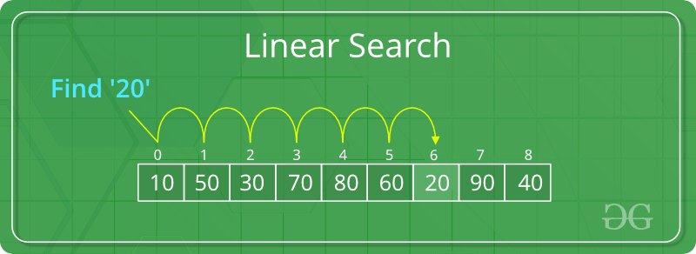
Example

Slide 21
Program of linear search
#include<iostream>
using namespace std;
int main()
{
int a[20],key,i,n, c=-1;
cout<<"Enter the number of elements:\t";
cin>>n;
cout<<"Enter the elements:\t";
for(i=0;i<n;i++)
cin>>a[i];
cout<<"Enter the element to be found \t";
cin>>key;
for(i=0;i<n;i++)
if(a[i]==key) //comparison
{
cout<<"Key found at location \t"<<i+1;
c++;
break;
}
if (c==-1)
cout<<"element not found in the list";
}

Slide 22
Output
Enter the number of elements: 4
Enter the element: 12 14
5
11
Enter a number to be found: 14 Key found at location 2

Slide 23
Binary search
Binary search
Applicable for sorted arrays
The algorithm locates the middle element of the array and compares it to the key value.
Compares middle element with the key
If equal, match found
If key < middle, looks in left half of middle
If key > middle, looks in right half of middle
Repeat (the algorithm is repeated on one-quarter of the original array.)

Slide 24
Binary search
It repeatedly divides the sequence in two, each time restricting the search to the half that would contain the element.
This is a tremendous increase in performance over the linear search that required comparing the search key to an average of half of the array elements.
You might use the binary search to look up a word in a dictionary

Slide 25
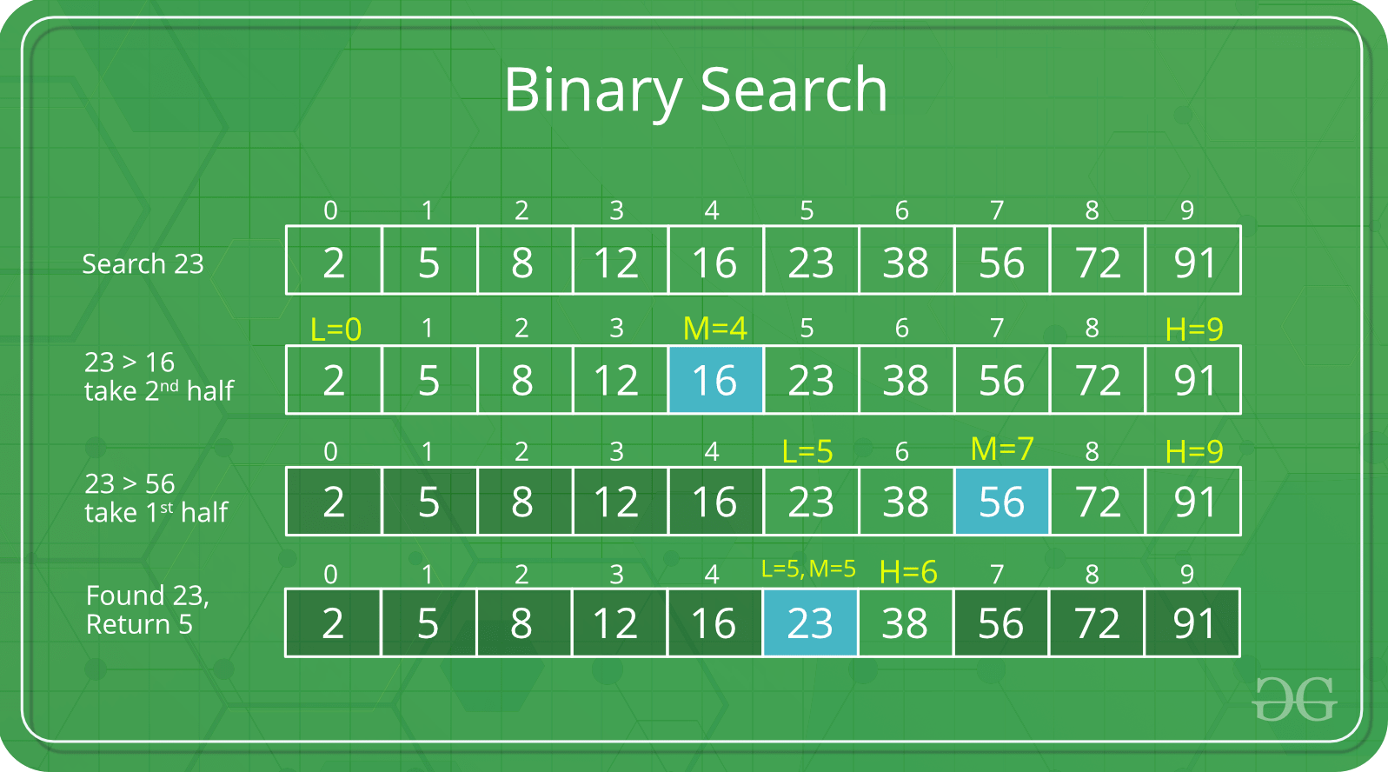
Example

Slide 26
Program of Binary search
#include<iostream>
using namespace std;
int main()
{
int ar[100],beg,mid,end,i,n,search;
cout<<"How many numbers in the array: "; cin>>n;
cout<<"Enter "<<n<<" numbers in ascending order --> "; for(i=0;i<n;i++)
cin>>ar[i]; beg=0;end=n-1;
cout<<"Enter a number to search: "; cin>>search;
while(beg<=end){
mid=(beg+end)/2;
if(ar[mid]==search)
cout<<"\nItem found at position"<<(mid+1); if(search>ar[mid])
beg=mid+1;
else
end=mid-1;
}
cout<<"\nSorry! "<<search<<" doesnot found.";
}

Slide 27
Output
How many numbers in the array: 4
Enter 4 numbers in ascending order→12 14
26
47
Enter a number to search:26 Item found at position 3

Slide 28
Bubble Sort
Bubble Sort is the simplest of the sorting techniques.
In the bubble sort technique, each of the elements in the list is compared to its adjacent element. Thus if there are n elements in list A, then A[0] is compared to A[1], A[1] is compared to A[2] and so on.
After comparing if the first element is greater than the second, the two elements are swapped then.
Larger elements move or ‘bubble’ up to the top of the list.

Slide 29
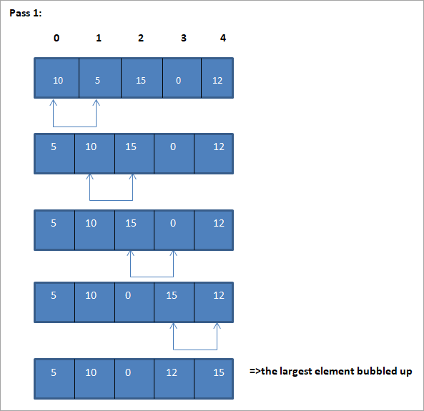

Slide 30
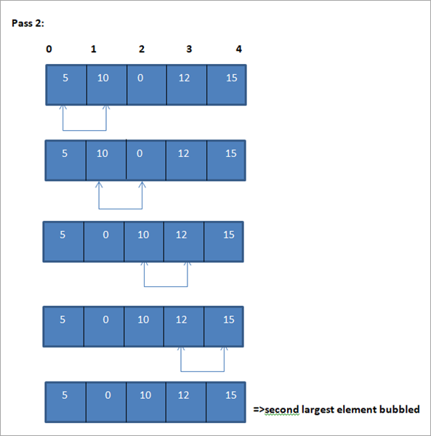

Slide 31
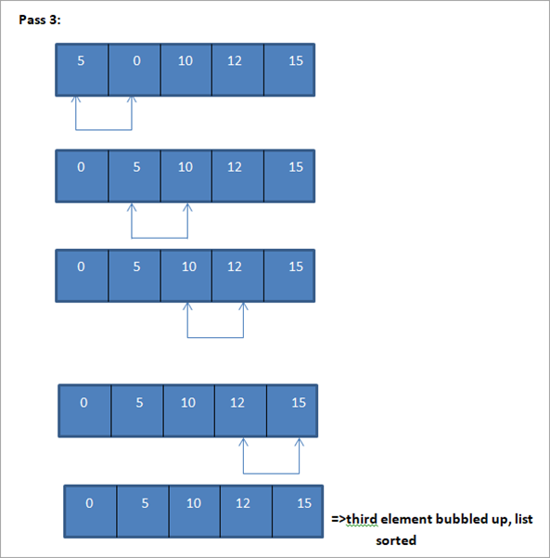

Slide 32
Bubble sort program
#include<iostream>
using namespace std;
int main()
{
int a[10],i,j,temp,n;
cout<<"Enter the max no. of elements to sort:"<<endl;
cin>>n;
cout<<"Enter the Elements :"<<endl;
for(i=0; i<n; i++)
{
cin>>a[i];
}
for(i=0; i<n-1; i++)
for(j=0; j<n-1-i; j++)
{
if(a[j]>a[j+1])
{
temp=a[j];
a[j]=a[j+1];
a[j+1]=temp;
}
}
cout<<"sorted array is"<<endl;
for(i=0; i<n; i++)
{
cout<<a[i]<<endl;
}
}

Slide 33
Two-Dimensional Array

Slide 34
Two-Dimensional Array
It is also possible for arrays to have two or more dimensions. The two dimensional array is also called matrix.
Syntax:
datatype variablename [rowsize] [columnsize];
Example:
int a[4][3];
Means that a -> is a two dimensional array, which contains 4 rows and 3 columns( total 12 elements). Each element is access by their row and column position.
0 1 2
Column offset
value
Address
Of a[0][0]
a[0][0]
1000
1006
0
1
a[0][2] 1004
?
2
3
Row offset
value

Slide 35
Two-Dimensional Array
Initialization
Example:
int array1[ 2 ][ 3 ] = { { 1, 2, 3 }, { 4, 5, 6 } };

Slide 36
Input To 2-D Array
1-D Array:
2-D Array:
int a[20],i;
for(i=0;i<20;i++)
{
cin>>a[ i ]);
}
int a[2][3],i,j;
for(i=0;i<2;i++)
{
for(j=0;j<3;j++)
{
cin>>a[i][j]);
}
}
Increment row index
Increment
column index
Note:
In this 2-D array example we will get input row by row. That means get rows
value one by one using inner for loop. Increment row using outer loop.

Slide 37
Program to input and display a matrix
#include<iostream>
using namespace std;
int main ()
{
int m, n, i, j, A[10][10];
cout << "Enter the number of rows and columns of the matrix : ";
cin >> m >> n;
cout << "Enter the array elements : ";
for (i = 0; i < m; i++)
for (j = 0; j < n; j++)
cin >> A[i][j];
cout << "Matrix : \n ";
for (i = 0; i < m; i++)
{
for (j = 0; j < n; j++)
cout << A[i][j] << " ";
cout << "\n ";
}
}

Slide 38
Program for addition of two matrix
#include<iostream>
using namespace std;
int main()
{
int i,j,mat1[2][2],mat2[2][2],mat3[2][2];
cout<<"Enter matrix matl";
for(i=0;i<2;i++)
for(j=0;j<2;j++)
cin>>mat1[i][j];
cout<<"Enter matrix mat2";
for(i=0;i<2;i++)
for(j=0;j<2;j++)
cin>>mat2[i][j];
for(i=0;i<2;i++)
for(j=0;j<2;j++)
mat3[i][j]=mat1[i][j]+mat2[i][j];
cout<<"The resultant matrix mat3 is:"<<endl;
for(i=0;i<2;i++)
{
for(j=0;j<2;j++)
cout<<mat3[i][j]<<" ";
cout<<endl;
}
}

Slide 39
Program to add the diagonal of square matrix
#include<iostream>
using namespace std;
int main( )
{
int mat[3][3],i,j, s1=0,s2=0;
for(i=0;i<3;i++)
for(j=0;j<3;j++)
{
cout<<"Enter the elements of matrix";
cin>>mat[i][j];
if(i==j)
s1=s1+mat[i][j];
if((i+j)==2)
s2=s2+mat[i][j];
}
cout<<"The matrix that you have entered is";
for(i=0;i<3;i++)
{
for(j=0;j<3;j++)
{
cout<<mat[i][j];
}
cout<<endl;
}
cout<<"The sum of matrix element is"<<s2;
}

Slide 40
Matrix Multiplication
In order to multiply two matrices, A and B, the number of columns in A must equal to the number of rows in B. Thus, if
Matrix A =m X n and
Matrix B = r X s then n=r.
Result of matrix includes =m X s

Slide 41
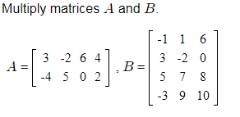
Example
We have (2×4) × (4×3) and since the number of columns in A is the same as the number of rows in B , we can go ahead and multiply these matrices.
Our result will be a (2×3) matrix.

Slide 42
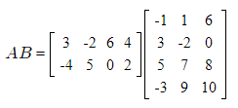
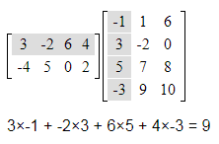
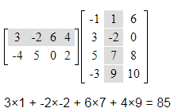
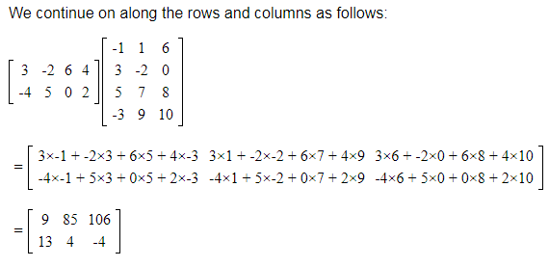
Steps

Slide 43
Program for multiplication of two matrix
#include<iostream>
using namespace std;
#define ROW1 3
#define COLl 4
#define ROW2 4
#define COL2 2
int main()
{
int matl[ROW1][COLl],
mat2[ROW2][COL2],
mat3[ROW1][COL2];
int i,j,k;
cout<<"Enter matrix matl:" ;
for(i=0;i<ROW1;i++)
for(j=0;j<COLl;j++)
cin>>matl[i][j] ;
cout<<"Enter matrix mat2:";
for(i=0;i<ROW2;i++)
for(j=0;j<COL2;j++)
cin>>mat2[i][j];
for(i=0;i<ROW1;i++)
for(j=0;j<COL2;j++)
{
mat3[i][j]=0;
for(k=0;k<COLl;k++)
mat3[i][j]+=matl[i][k]*mat2[k][j];
}
cout<<"The Resultant matrix mat3 is :"<<endl ;
for(i=0;i<ROW1;i++)
{
for(j=0;j<COL2;j++)
cout<<mat3[i][j]<<" ";
cout<<endl;
}
}

